Slide 1
Machine Learning Day
Cuauhtemoc Anda
Pieter Fourie

Slide 2
Machine Learning
Machine Learning
Linear
Algebra
Statistics
Optimization
Computer Science
Neuroscience
Vector Calculus
Objective
The design of computer algorithms to perform a specific task without using explicit instructions, relying on patterns in the data and inference instead.

Slide 3
Types of Learning
Supervised Learning { X , y }
Unsupervised Learning { X }
Reinforcement Learning { X , y , r }

Slide 4
Scope of this course
Supervised Learning:
Classification
Models:
Logistic Regression, Softmax Regression, Decision Tree, Random Forest
ML concepts:
Predictive Function, Cost Function, Overfitting, Cross Validation, Regularization, Bagging
Concept
explanation
+
Mathematical
explanation
+
R Lab
exercises

Slide 5
Sections
Machine Learning Basics
Logistic Regression
Basis Functions
Softmax Regression
Regularization
Decision Tree
Random Forest

Slide 6
The Multidimensional (Data) Space
1. Machine Learning Basics

Slide 7
General Strategy
1. Machine Learning Basics
Problem Setting
Model / Predictive Function
Cost / Loss Function
Parameter Estimation (Learning)
Model Validation / Generalization

Slide 8
General Strategy
1. Machine Learning Basics
Problem Setting
Model / Predictive Function
Cost / Loss Function
Parameter Estimation (Learning)
Model Validation / Generalization
Regression { x , y } , y e R, x e Rp
Y^ = b0 + b1*x1 + b2 +x2 … (Linear model)
MSE(b) -> sum(y_hat - y)^2 / N (Mean Squared Error)
b -> ( X T X )-1 ( X T y )
Mean Squared Error

Slide 9
Classification
1. Machine Learning Basics
Problem Setting
Probabilistic vs Non probabilistic output
Confusion Matrix
Accuracy
AUC

Slide 10
Model Validation / Generalization
1. Machine Learning Basics
Splitting the Data:
1st case:
2nd case:
Training
Testing
Training
Validation
Testing

Slide 11
Cross Validation
1. Machine Learning Basics
Leave-one-out Cross Validation
N=9
1
2
3
4
5
6
7
8
9
1
2
3
4
5
6
7
8
9
1
2
3
4
5
6
7
8
9
.
.
.
Training
Testing

Slide 12
Cross Validation
1. Machine Learning Basics
K-fold Cross Validation
N=9
K=3
1 2 3
4 5 6
7 8 9
1 2 3
4 5 6
7 8 9
1 2 3
4 5 6
7 8 9
Training
Testing

Slide 13
Cross Validation
1. Machine Learning Basics
Monte Carlo Cross Validation
N=10
70% train
30% test
10 4 7 3 6 1 9
2 8 5
4 2 7 9 5 8 6
10 1 3
2 1 7 10 6 8 3
4 9 5
5 10 4 3 8 1 9
6 7 2
.
.
.
Training
Testing

Slide 14
Sections
Machine Learning Basics
Logistic Regression
Basis Functions
Softmax Regression
Regularization
Decision Tree
Random Forest

Slide 15
Logistic Regression
2. Logistic Regression
= Logit model
Setting?
Predictive Function?
Loss Function?
Parameter Estimation?
Model Validation
Notes:
Lab Ex. 1 -> 1part: gradient descent, 2part: decision boundary, 3part: Validation, 4part: Cross Validation

Slide 16
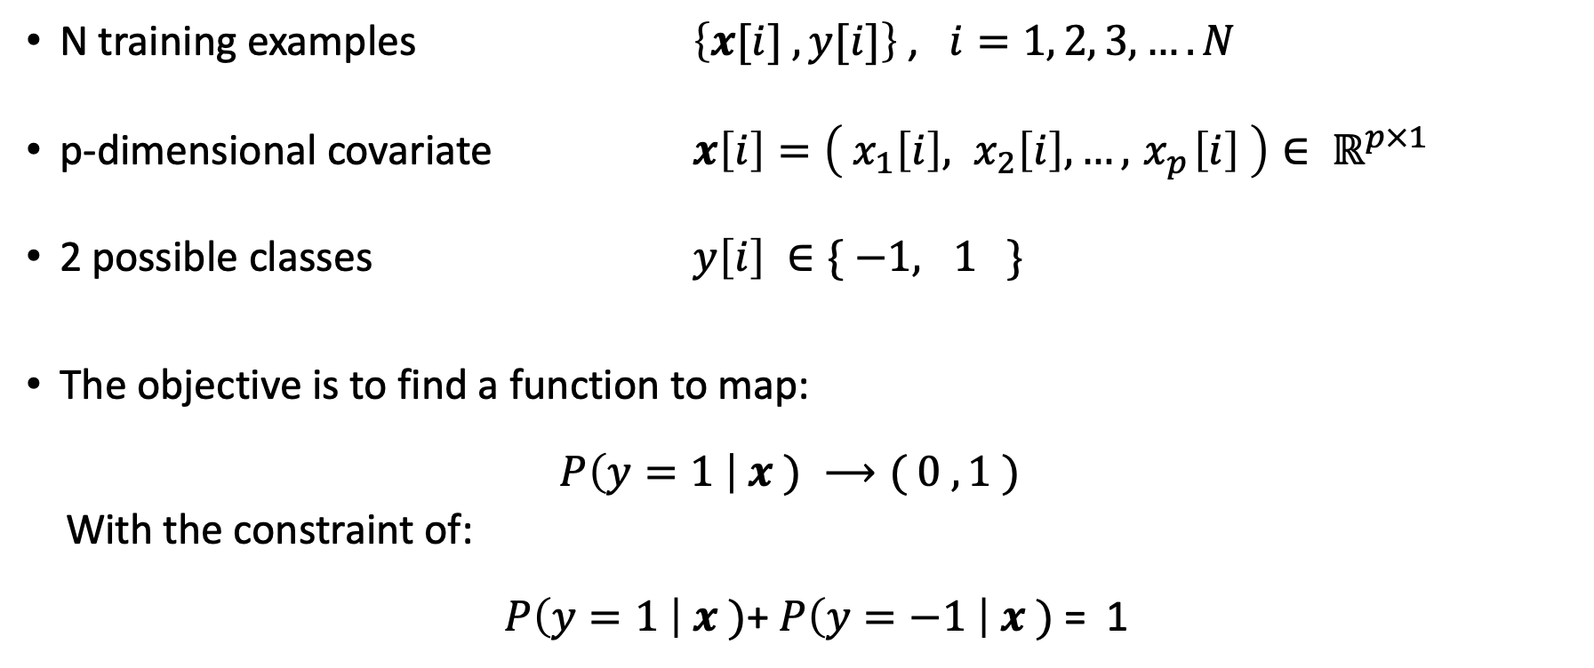
Setting
2. Logistic Regression
N training examples $\left\{x[i] , y[i]\right\}$ , $i=1, 2, 3,…. N$
p-dimensional covariate $x\left[i\right]=\left({ x}_{1}\left[i\right], x_{2}\left[i\right], …,{ x}_{p}\left[i\right] \right)∈ ℝ^{p×1}$
2 possible classes $y\left[i\right] ∈\{ −1, 1 \}$
The objective is to find a function to map:
$P\left(y=1 \right| x ) ⟶( 0 ,1 )$
With the constraint of:
$P\left(y=1 \right| x )$+ $P\left(y=−1 \right| x )$= 1
Notes:
Lab Ex. 1 -> 1part: gradient descent, 2part: decision boundary, 3part: Validation, 4part: Cross Validation

Slide 17
Logistic Regression
2. Logistic Regression
= Logit model
Setting
Predictive Function?
Loss Function?
Parameter Estimation?
Model Validation
Notes:
Lab Ex. 1 -> 1part: gradient descent, 2part: decision boundary, 3part: Validation, 4part: Cross Validation

Slide 18
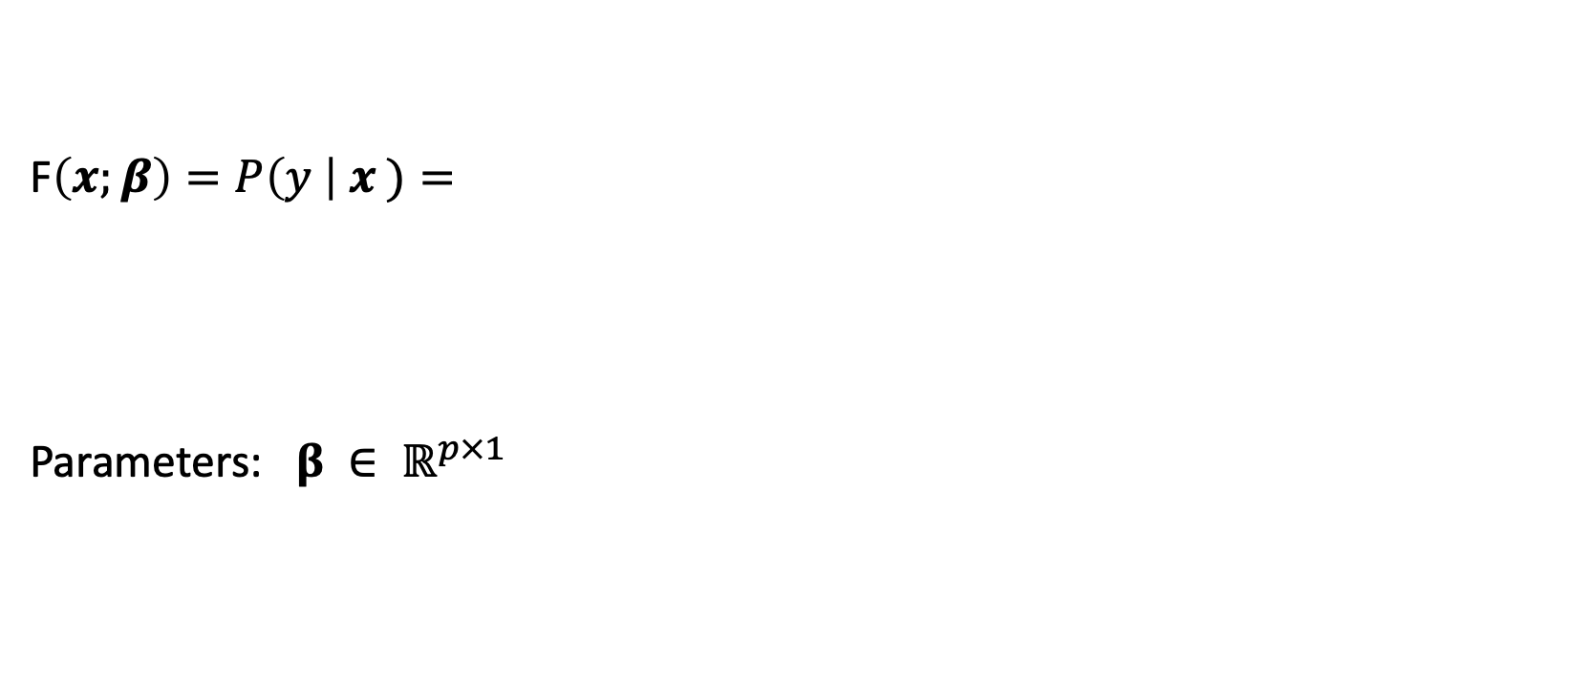
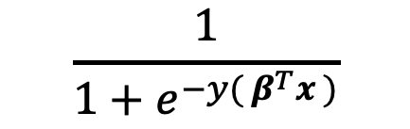
Predictive Function
2. Logistic Regression
F$\left(x;β\right)=P\left(y \right| x )=$
Parameters: $β ∈ ℝ^{p×1}$
$$\frac{1}{1+e^{−y( β^{T}x )}}$$
Notes:
Lab Ex. 1 -> 1part: gradient descent, 2part: decision boundary, 3part: Validation, 4part: Cross Validation

Slide 19
Logistic Regression
2. Logistic Regression
= Logit model
Setting
Predictive Function
Loss Function?
Parameter Estimation?
Model Validation
Notes:
Lab Ex. 1 -> 1part: gradient descent, 2part: decision boundary, 3part: Validation, 4part: Cross Validation

Slide 20
Loss Function
2. Logistic Regression
Loss function should be differentiable and convex
Options:
Misclassification ->not differentiable
Negative Log Likelihood
Notes:
Lab Ex. 1 -> 1part: gradient descent, 2part: decision boundary, 3part: Validation, 4part: Cross Validation

Slide 21
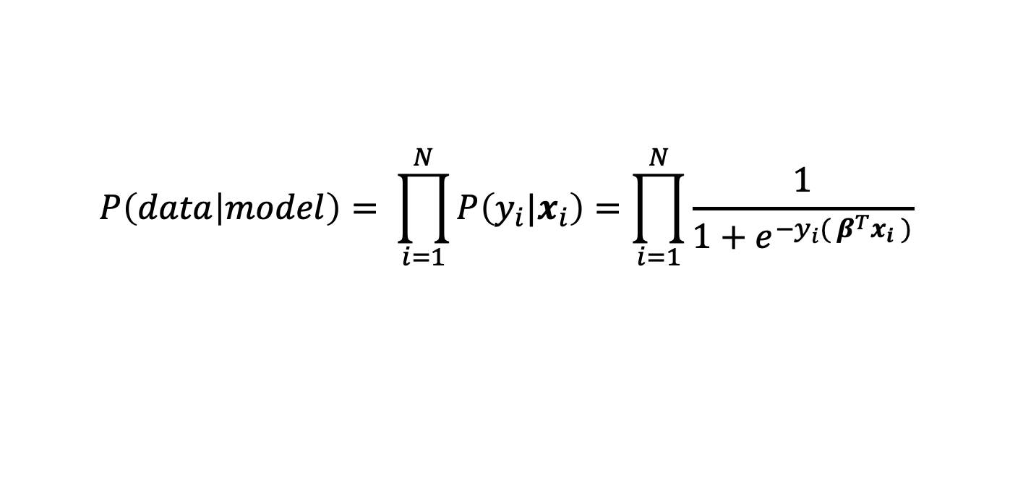
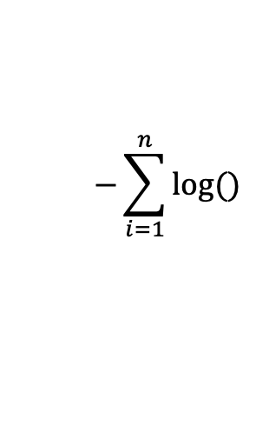
Maximum Likelihood Estimation
2. Logistic Regression
Likelihood:
Negative log likelihood:
$$P\left(data | model\right)= \prod_{i=1}^{N}{P\left({y_{i}|x}_{i}\right)=\prod_{i=1}^{N}{\frac{1}{1+e^{−y_{i}( β^{T}x_{i} )}}}}$$
$$−\sum_{i=1}^{n}{log()}$$
Notes:
Lab Ex. 1 -> 1part: gradient descent, 2part: decision boundary, 3part: Validation, 4part: Cross Validation

Slide 22
Logistic Regression
2. Logistic Regression
= Logit model
Setting
Predictive Function
Loss Function
Parameter Estimation?
Model Validation
Notes:
Lab Ex. 1 -> 1part: gradient descent, 2part: decision boundary, 3part: Validation, 4part: Cross Validation

Slide 23
Logistic Regression
2. Logistic Regression
= Logit model
Setting
Predictive Function
Loss Function
Parameter Estimation
Model Validation
Notes:
Lab Ex. 1 -> 1part: gradient descent, 2part: decision boundary, 3part: Validation, 4part: Cross Validation

Slide 24
Logistic Regression
2. Logistic Regression
= Logit model
Objective: Binary class
Model / Predictive Function
Loss Function
Importance of Differentiability
Parameter Estimation (proof)
Gradient Descent
Model Validation
Decision Boundary
(Lab Ex. 1)
Setting
Predictive Function?
Loss Function?
Parameter Estimation?
Model Validation?
Notes:
Lab Ex. 1 -> 1part: gradient descent, 2part: decision boundary, 3part: Validation, 4part: Cross Validation

Slide 25
Sections
Machine Learning Basics
Logistic Regression
Basis Functions
Softmax Regression
Regularization
Decision Tree
Random Forest

Slide 26
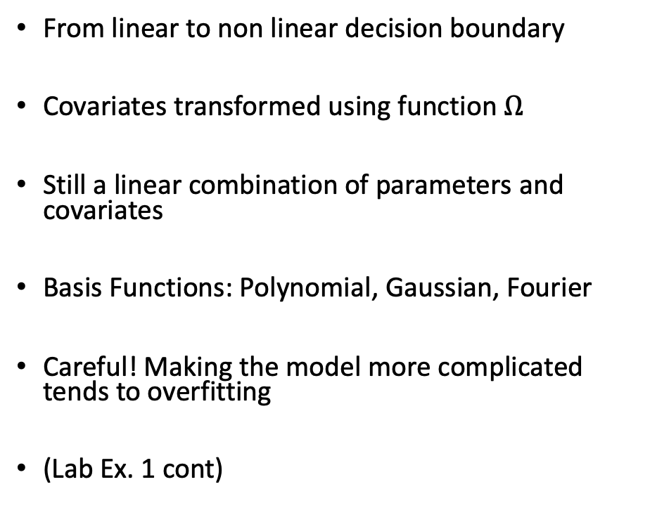
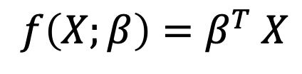
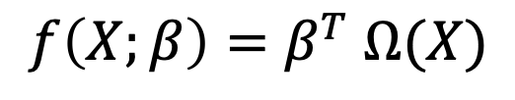
Basis Functions
3. Basis Functions
From linear to non linear decision boundary
Covariates transformed using function $Ω$
Still a linear combination of parameters and covariates
Basis Functions: Polynomial, Gaussian, Fourier
Careful! Making the model more complicated tends to overfitting
(Lab Ex. 1 cont)
$${f\left(X;β\right)=β}^{T} X$$
$${f\left(X;β\right)=β}^{T} Ω(X)$$
Notes:
Lab Ex. 1 -> 5part: polynomial expansion of design matrix, 6part: choose best degree of polynomial

Slide 27
Sections
Machine Learning Basics
Logistic Regression
Basis Functions
Softmax Regression
Regularization
Decision Tree
Random Forest

Slide 28
Softmax Regression
4. Softmax Regression
= Multinomial Logistic Regression
= Multinomial Logit Model
Setting?
Predictive Function?
Loss Function?
Parameter Estimation?
Model Validation?
Notes:
Lab Ex. 1 -> 5part: polynomial expansion of design matrix, 6part: choose best degree of polynomial

Slide 29
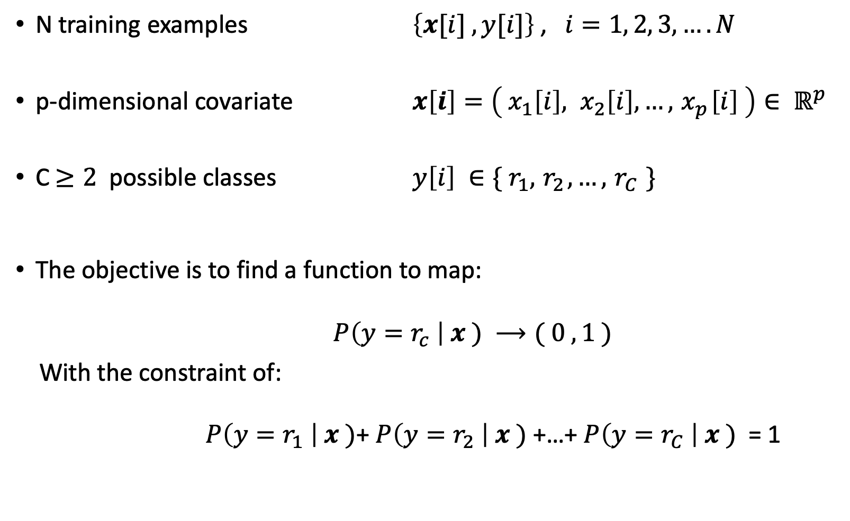
Setting
4. Softmax Regression
N training examples $\left\{x[i] , y[i]\right\}$ , $i=1, 2, 3,…. N$
p-dimensional covariate $x\left[i\right]=\left({ x}_{1}\left[i\right], x_{2}\left[i\right], …,{ x}_{p}\left[i\right] \right)∈ ℝ^{p}$
C$≥2$ possible classes $y\left[i\right] ∈\{ r_{1},{ r}_{2},…,{ r}_{C} \}$
The objective is to find a function to map:
$P\left(y=r_{c} \right| x ) ⟶( 0 ,1 )$
With the constraint of:
$P\left(y=r_{1} \right| x )$+ $P\left(y=r_{2} \right| x )$+…+ $P\left(y=r_{C} \right| x )$ = 1
Notes:
Lab Ex. 1 -> 5part: polynomial expansion of design matrix, 6part: choose best degree of polynomial

Slide 30
Softmax Regression
4. Softmax Regression
= Multinomial Logistic Regression
= Multinomial Logit Model
Setting
Predictive Function?
Loss Function?
Parameter Estimation?
Model Validation?
Notes:
Lab Ex. 1 -> 5part: polynomial expansion of design matrix, 6part: choose best degree of polynomial

Slide 31
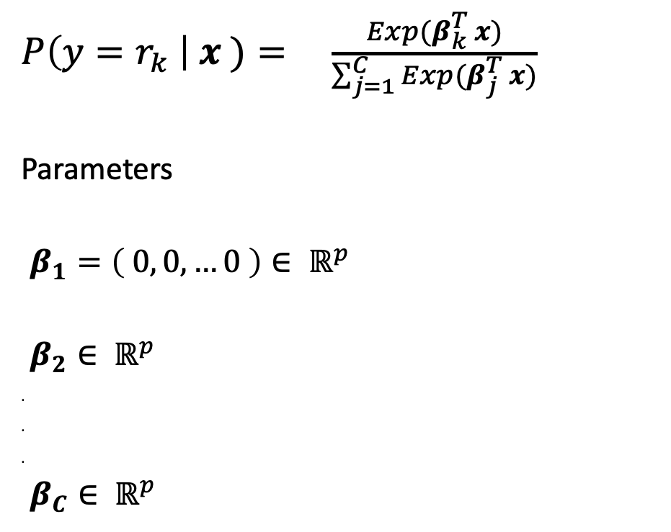
Predictive Function
4. Softmax Regression
$P\left(y=r_{k} \right| x )= \frac{Exp(β_{k}^{T} x)}{\sum_{j=1}^{C}{Exp(β_{j}^{T} x)}}$
Parameters
.$β_{1}=\left( 0, 0,…0 \right)∈ ℝ^{p}$
.$β_{2}∈ ℝ^{p}$
.
.
.
.$β_{C}∈ ℝ^{p}$
Notes:
Lab Ex. 1 -> 5part: polynomial expansion of design matrix, 6part: choose best degree of polynomial

Slide 32
Softmax Regression
4. Softmax Regression
= Multinomial Logistic Regression
= Multinomial Logit Model
Setting
Predictive Function
Loss Function?
Parameter Estimation?
Model Validation?
Notes:
Lab Ex. 1 -> 5part: polynomial expansion of design matrix, 6part: choose best degree of polynomial

Slide 33
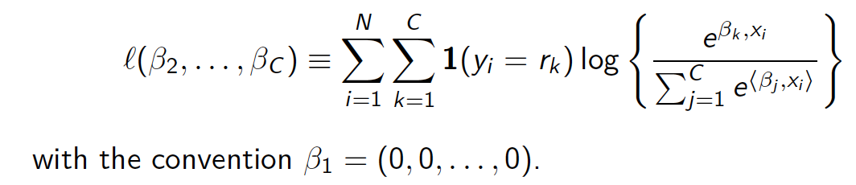
Loss Function
4. Softmax Regression
Probabilistic model -> Likelihood
The log likelihood is:
We want a loss function -> negative log-likelihood (Cross-Entropy)
Notes:
Lab Ex. 1 -> 5part: polynomial expansion of design matrix, 6part: choose best degree of polynomial

Slide 34
Softmax Regression
4. Softmax Regression
= Multinomial Logistic Regression
= Multinomial Logit Model
Setting
Predictive Function
Loss Function
Parameter Estimation?
Model Validation?
Notes:
Lab Ex. 1 -> 5part: polynomial expansion of design matrix, 6part: choose best degree of polynomial

Slide 35
Parameter Estimation
4. Softmax Regression
The negative log-likelihood or cross entropy loss is differentiable and convex.
Use gradient descent to find the parameters.
Notes:
Lab Ex. 1 -> 5part: polynomial expansion of design matrix, 6part: choose best degree of polynomial

Slide 36
Softmax Regression
4. Softmax Regression
= Multinomial Logistic Regression
= Multinomial Logit Model
Setting
Predictive Function
Loss Function
Parameter Estimation
Model Validation?
To do: Lab Ex.
Notes:
Lab Ex. 1 -> 5part: polynomial expansion of design matrix, 6part: choose best degree of polynomial

Slide 37
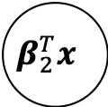
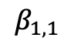
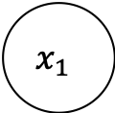
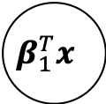
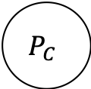
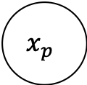
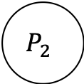
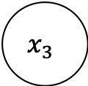
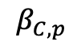

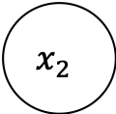
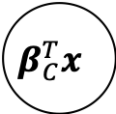
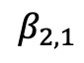
Relation to Neural Networks
4. Softmax Regression
Last layer of many deep learning classifiers
#classes
Softmax layer
P
r
o
b
a
b
i
l
i
t
i
e
s
$$x_{1}$$
$$β_{1,1}$$
$$β_{1}^{T}x$$
$$P_{1}$$
C
o
v
a
r
i
a
t
e
s
$$β_{2,1}$$
$$x_{2}$$
$$β_{2}^{T}x$$
$$P_{2}$$
.
.
.
$$x_{3}$$
$$β_{C}^{T}x$$
$$P_{C}$$
.
.
.
$$β_{C,p}$$
$$x_{p}$$

Slide 38
Sections
Machine Learning Basics
Logistic Regression
Basis Functions
Softmax Regression
Regularization
Decision Tree
Random Forest

Slide 39
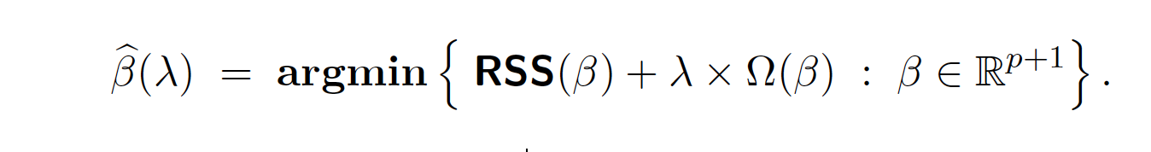
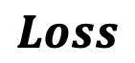
Regularization
5. Regularization
Regularization: Strategies to avoid overfitting
Large values in the coefficients are associated with overfitting…
Penalize the size of the coefficients 𝛃
Keep the value of Betas low -> Shrinkage methods
$$Loss$$
How much you penalize the size of the coefficients

Slide 40
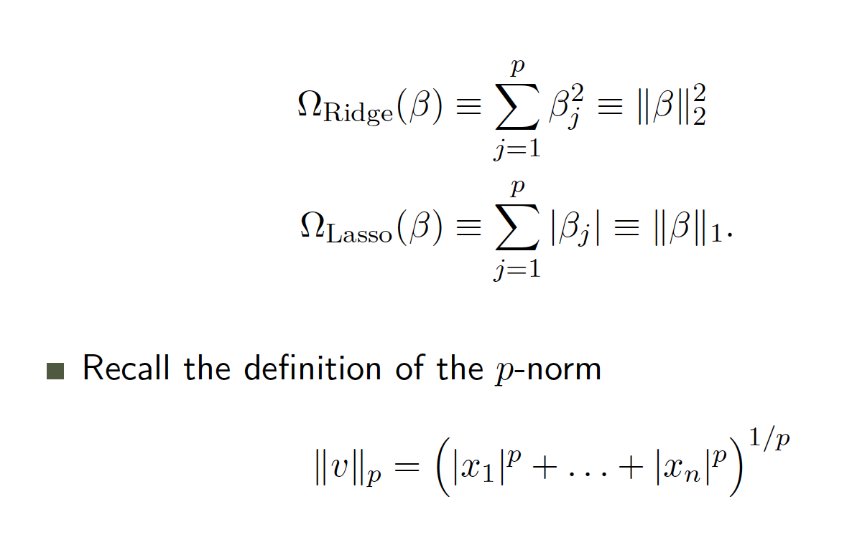
Regularization
5. Regularization
Ridge vs Lasso
Difference is in the function that penalizes the coefficients
Ridge or L2-norm: Sum of squares
Lasso or L1-norm: Sum of absolute val.
P-norm definition:

Slide 41
Ridge vs Lasso
5. Regularization
Difference is in the function that penalizes the coefficients
Ridge or L2-norm: Sum of squares
Lasso or L1-norm: Sum of absolute val.
P-norm definition:

Slide 42
Ridge vs Lasso
5. Regularization
Lasso
Ridge

Slide 43
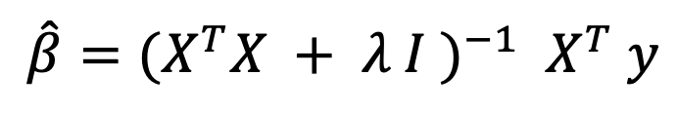
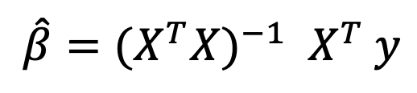
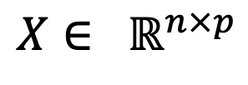
Why does it work?
5. Regularization
Data in real life is pathological (e.g. correlated, outliers)
Not interested in goodness of fit
Also, case p > n
Solution of linear regression:
Solution with L2 norm
$$\hat{β}={{(X}^{T}X)}^{−1}{ X}^{T} y$$
$$X∈ ℝ^{n×p}$$
$$\hat{β}={{(X}^{T}X + λ I )}^{−1}{ X}^{T} y$$

Slide 44
Lamda
5. Regularization
How much we penalize the size of coefficients
How to set 𝛌 ?
(Lab Ex)

Slide 45
Sections
Machine Learning Basics
Logistic Regression
Basis Functions
Softmax Regression
Regularization
Decision Tree
Random Forest

Slide 46
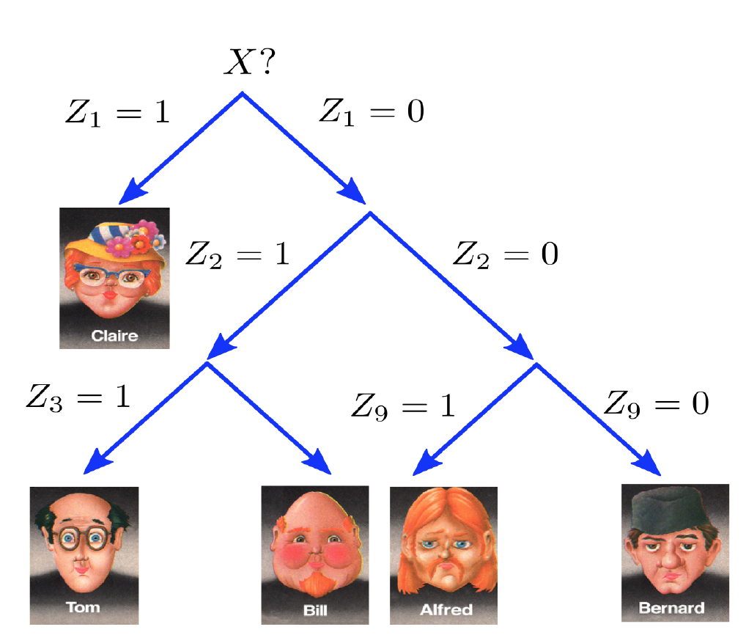
Decision Trees
6. Decision Trees

Slide 47
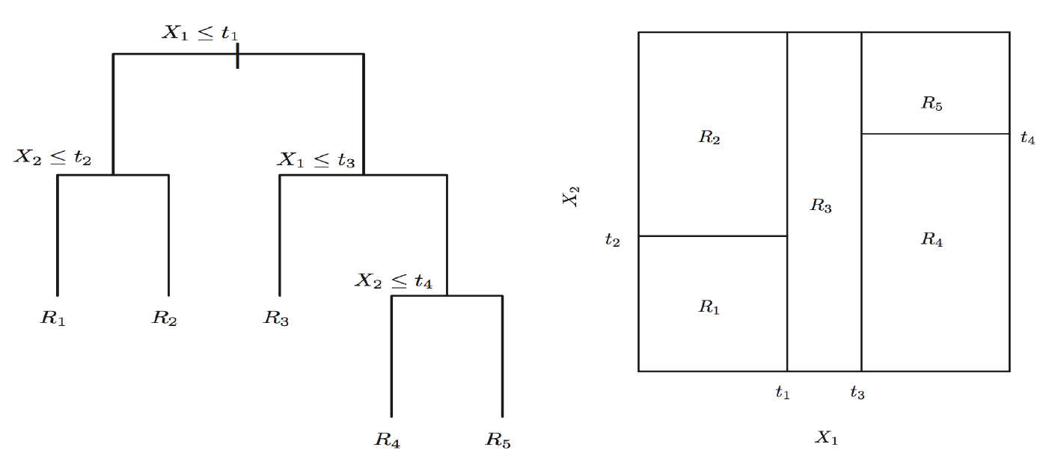
Decision Trees
6. Decision Trees
Not a linear combination, but a a recursive partition of the feature space

Slide 48
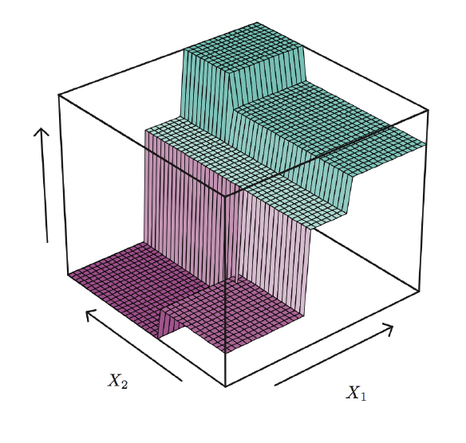
Decision Trees
6. Decision Trees
Not a linear combination, but a a recursive partition of the feature space

Slide 49
Decision Trees
6. Decision Trees
Setting: Classification
Predictive Function?
Loss Function?
Parameter Estimation?
Model Validation

Slide 50
Predictive Function
6. Decision Trees
X2
X1

Slide 51
Predictive Function
6. Decision Trees
X1>1
X2
( , )
X2>2
( 0 , 4 )
2
X1>2
X1>1.7
( 1 , 3 )
( 3 , 1 )
( 5 , 0 )
( 1 , 4 )
1
1.7
2
X1

Slide 52
Predictive Function
6. Decision Trees
X1>1
X2
( , )
X2>2
( 0 , 4 )
2
X1>2
X1>1.7
?
( 1 , 3 )
( 3 , 1 )
( 5 , 0 )
( 1 , 4 )
1
1.7
2
X1

Slide 53
Predictive Function
6. Decision Trees
X1>1
X2
( , )
X2>2
( 0 , 4 )
2
X1>2
X1>1.7
?
( 1 , 3 )
( 3 , 1 )
( 5 , 0 )
( 1 , 4 )
1
1.7
2
X1

Slide 54
Predictive Function
6. Decision Trees
X1>1
X2
( , )
X2>2
( 0 , 4 )
2
X1>2
X1>1.7
( 1 , 3 )
( 3 , 1 )
( 5 , 0 )
( 1 , 4 )
1
1.7
2
X1

Slide 55
Predictive Function
6. Decision Trees
X1>1
X2
( R5 )
( R4 )
X2>2
( R1 )
2
X1>2
X1>1.7
( R1 )
( R2 )
( R3 )
( R2 )
( R3 )
( R4 )
( R5 )
1
1.7
2
X1

Slide 56
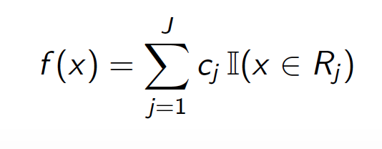
Predictive Function
6. Decision Trees
X2
( R5 )
( R4 )
2
( R1 )
( R2 )
( R3 )
1
1.7
2
X1

Slide 57
Decision Trees
6. Decision Trees
Setting: Classification
Predictive Function
Loss Function?
Parameter Estimation?
Model Validation

Slide 58
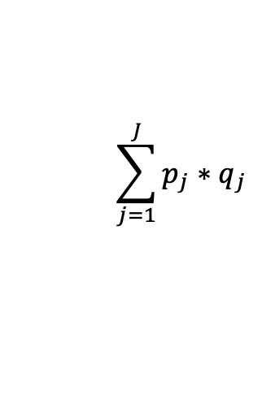
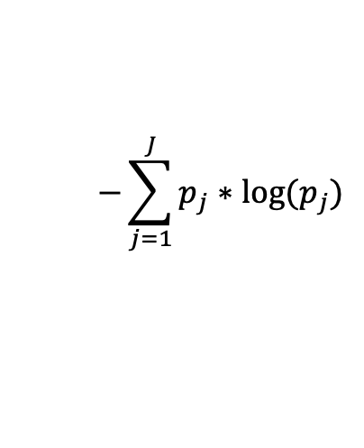
Loss function
6. Decision Trees
( p=success , q=failure )
Misclassification
Measurement of Purity
Gini Index:
Cross-Entropy:
X2
( 1 , 0 )
( 4/5, 1/5 )
$$\sum_{j=1}^{J}{p_{j}∗q_{j}}$$
2
$$−\sum_{j=1}^{J}{p_{j}∗{log⁡(p}_{j})}$$
( 1, 0 )
( 3/4 , 1/4)
( 3/4 , 1/4 )
1
1.7
2
X1

Slide 59
Decision Trees
6. Decision Trees
Setting: Classification
Predictive Function
Loss Function
Parameter Estimation?
Model Validation

Slide 60
Parameter Estimation
6. Decision Trees
= Growing a Tree
Parameters: Splits
Too expensive to find optimal splits (recursive nature)
Solution: Greedy approach
Algorithm:
At each step select the variable and the split that decreases the Gini index or Cross-Entropy the most.
Continue until a small number of training samples (e.g. ≤ 5) are left on each leaf

Slide 61
Decision Trees
6. Decision Trees
Setting: Classification
Predictive Function
Loss Function
Parameter Estimation
Model Validation

Slide 62
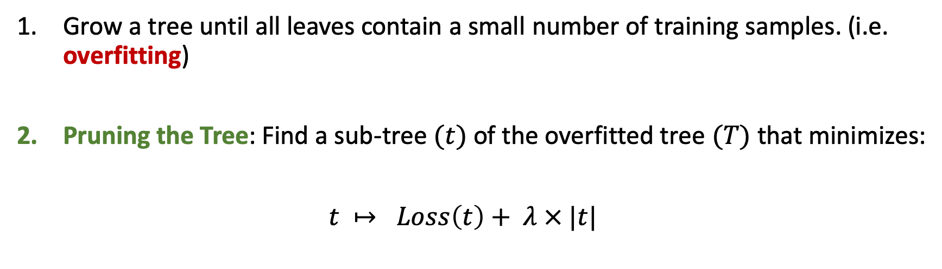
Growing a Tree in practice
6. Decision Trees
Grow a tree until all leaves contain a small number of training samples. (i.e. overfitting)
Pruning the Tree: Find a sub-tree $(t)$ of the overfitted tree $(T)$ that minimizes:
$t ↦ Loss\left(t\right)+ λ × |t|$
To do: Lab Ex. 3 (Tree)

Slide 63
Decision Trees
6. Decision Trees
Advantages
Easy to interpret
Can be displayed graphically
Disadvantages
Generally not good performance
Extremely sensitive to the training examples

Slide 64
Sections
Machine Learning Basics
Logistic Regression
Basis Functions
Softmax Regression
Regularization
Decision Tree
Random Forest

Slide 65
Bias vs. Variance
7. Random Forest
Prediction error can be decomposed into a bias error and a variance error

Slide 66
Bagging = Bootstrap Aggregating
7. Random Forest
Bootstrap samples: subsets of data chosen randomly with replacement.

Slide 67
Bagging = Bootstrap Aggregating
7. Random Forest
Notes:
Ensemble: take average. Advantage probabilistic output

Slide 68
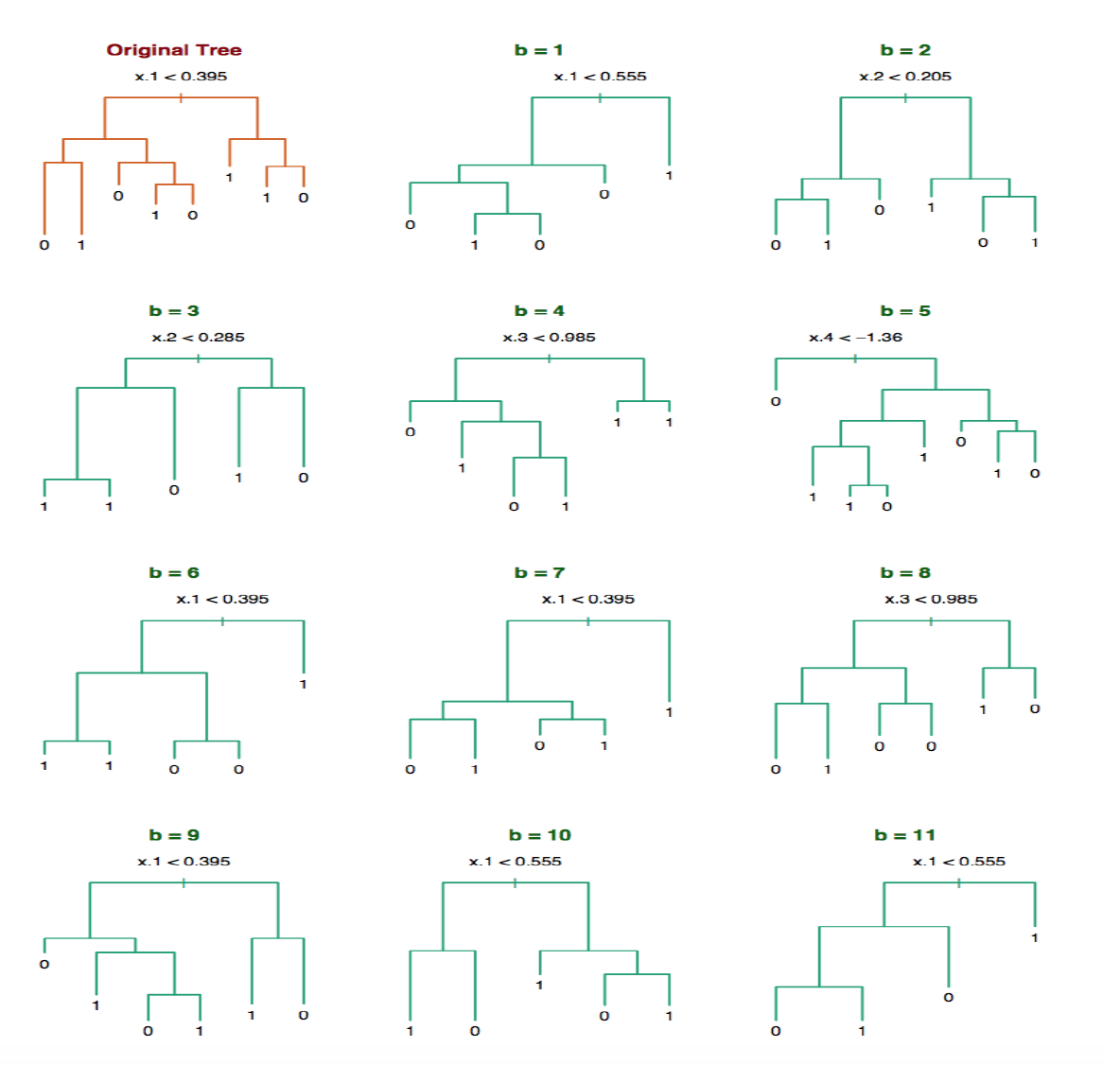
Bagging Trees
7. Random Forest
Notes:
1) Bagging logistic regression / linear regression? 2) How can we improve our bag of trees. The more different the better, How to make the trees more different?

Slide 69
Random Forest
7. Random Forest
Algorithm
Select m predictors at random from the p available predictors.
Pick the best variable/split-point among the m.
Split the node into two daughter nodes.
Iterate until a full tree is grown
*In practice m = sqrt(p) is often a reasonable choice
Bagging Trees with random subset of predictors
Make trees less correlated
Advantages
Easy to implement
No need of dummy variables
No need of scaling variables
Feature correlation ok
No hard model assumptions
General good performance
Probabilistic output
Variable Importance
(Lab Ex. 5)

Slide 70
Bonus Datasets (1)
Handwritten Digit Recognition
(mnist dataset)
28x28 pixels
0-255 pixel value

Slide 71
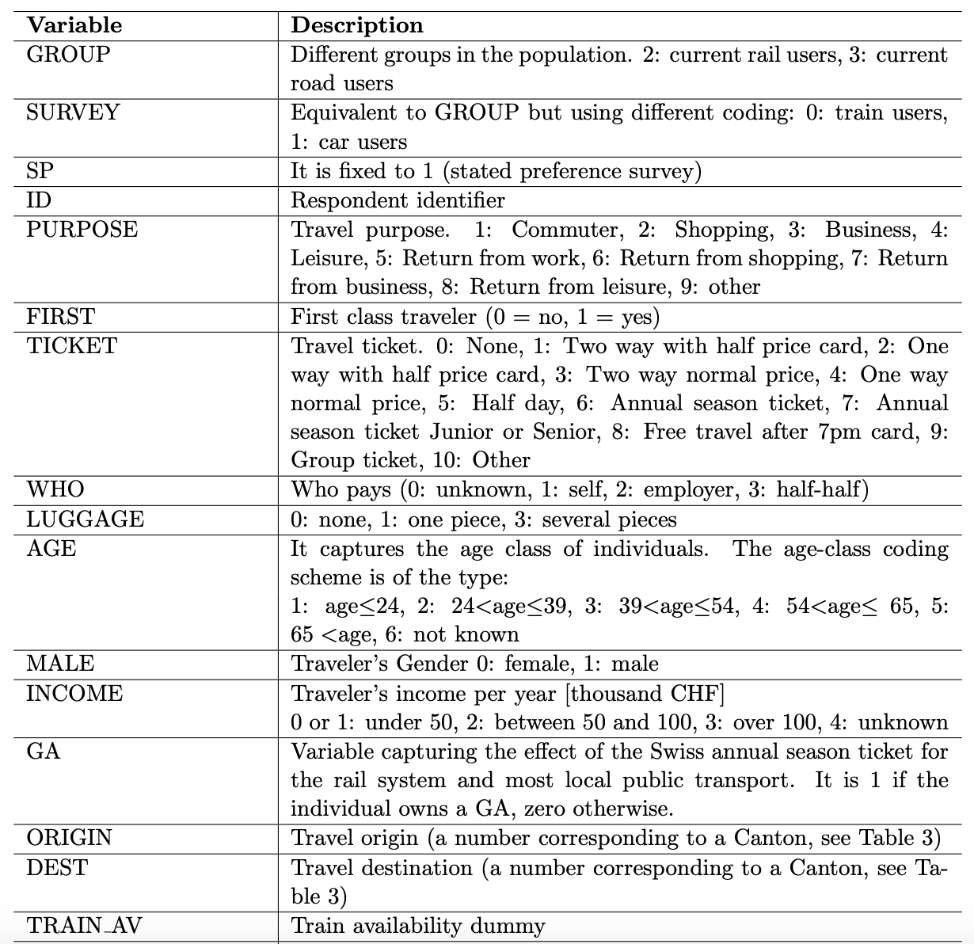
Bonus Datasets (2)
Swissmetro dataset
RP survey of mode choice in Switzerland
3 Labels: Rail, Swissmetro, Car

Slide 72
Sections
Machine Learning Basics
Logistic Regression
Basis Functions
Softmax Regression
Regularization
Decision Tree
Random Forest
Bonus: Neural Networks

Slide 73
Multilayer Perceptron
8. Neural Networks
From Softmax Regression to the Multilayer Perceptron
Linear combination + activation function

